Slide 1


PATHOLOGYLAB MANAGEMENT SYSTEM

Slide 2
GROUP 1
Instructor: Mr. Luong The Anh
Students:
A19084 - Pham Quoc Anh
A19088 - Tran Thanh Quang
A19079 - Doan Lan Anh
A18115 - Nguyen Thuy Van

Slide 3
Problem definition
Life Line is a pathology laboratory that performs different types of tests.
Previously, the lab was only to perform selected tests but with patient response and doctor's request, they added new tests.It should be difficult to manage patient reports and details of other tests.
Therefore, the laboratory decided to develop laboratory management software.
This system provides general, concise and accurate information regarding the provision of investigation information such as patient details, inventory, purchase details, patient details, billing, etc.

Slide 4
Overview of processes involved in the system
Login, Logout (The login portal appears every time you enter the system, asking the user to confirm the access. The system contains three login: Admin, Doctor, Staff).
Administrator:
Add/edit doctor account
Add/edit staff account
Add/edit login account.

Slide 5
Staff:
Add/edit patient detail
Add/edit medicine stock.
Check bill detail.
Change password Staff account
Doctor:
View/edit report.
Add/edit test information.
Change password Doctor account

Slide 6
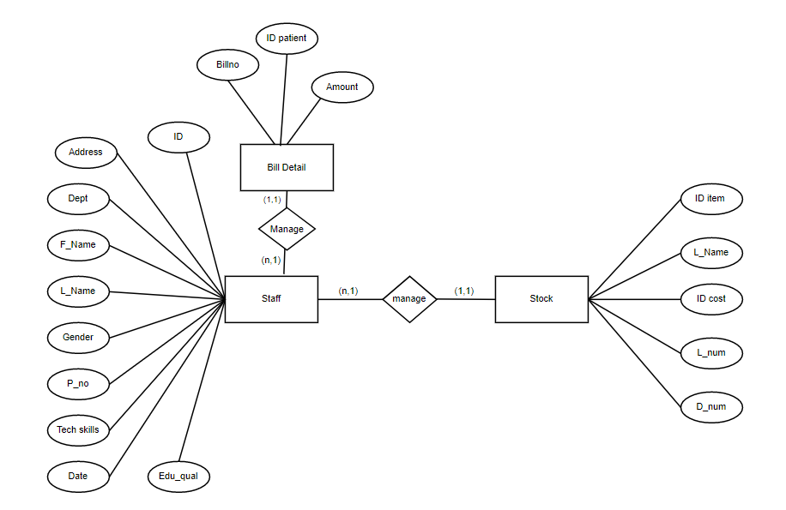
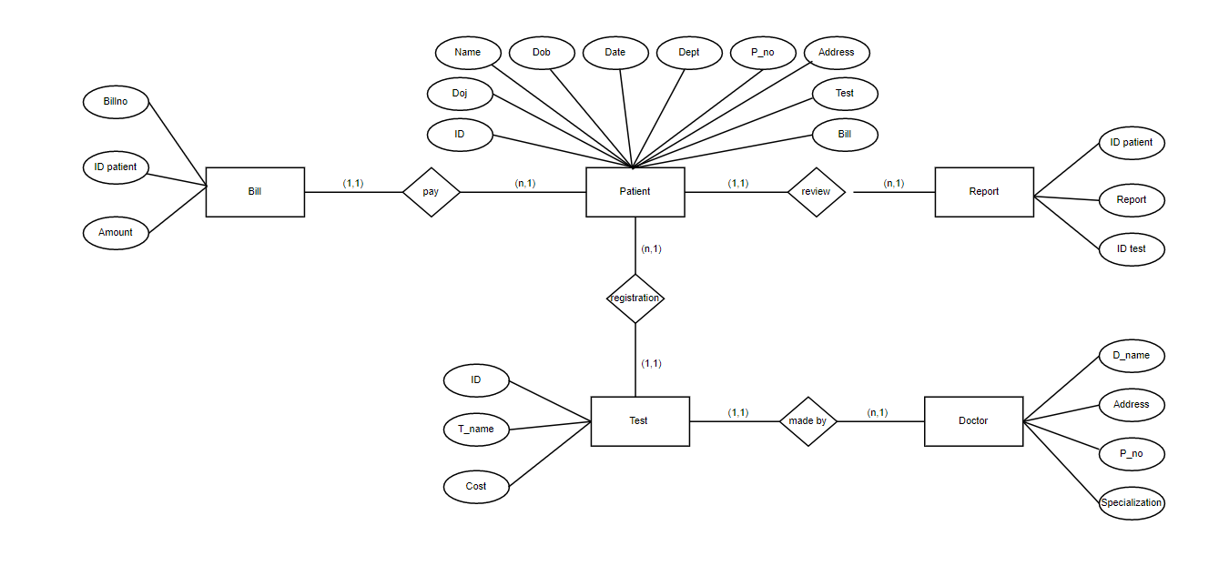
ENTITY RELATIONSHIP MODEL

Slide 7
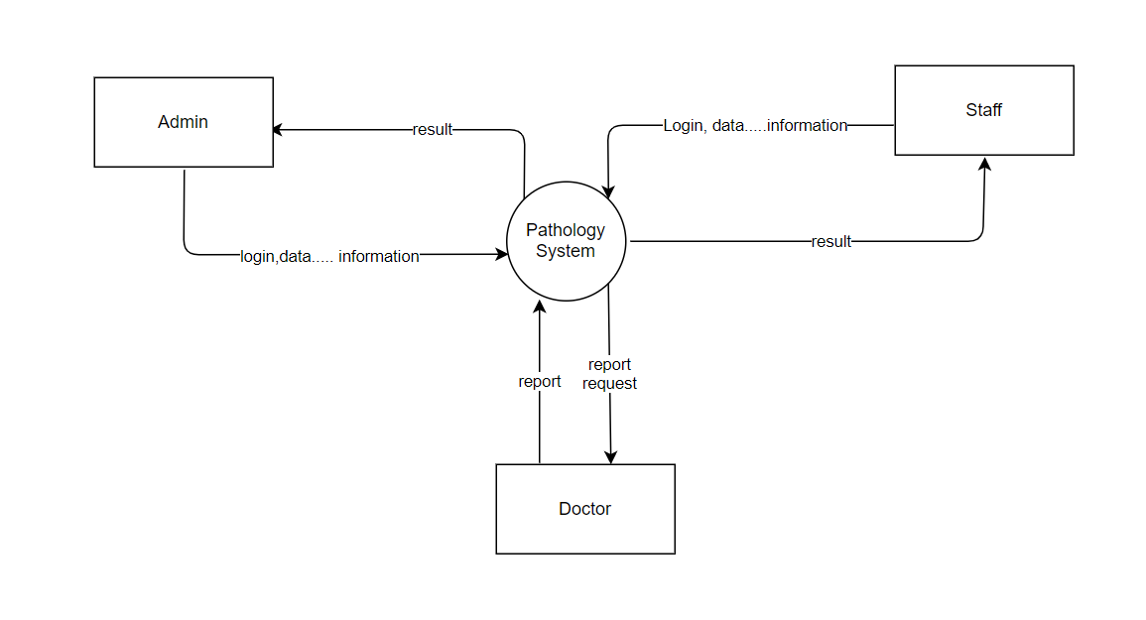
CONTEXT LEVEL

Slide 8
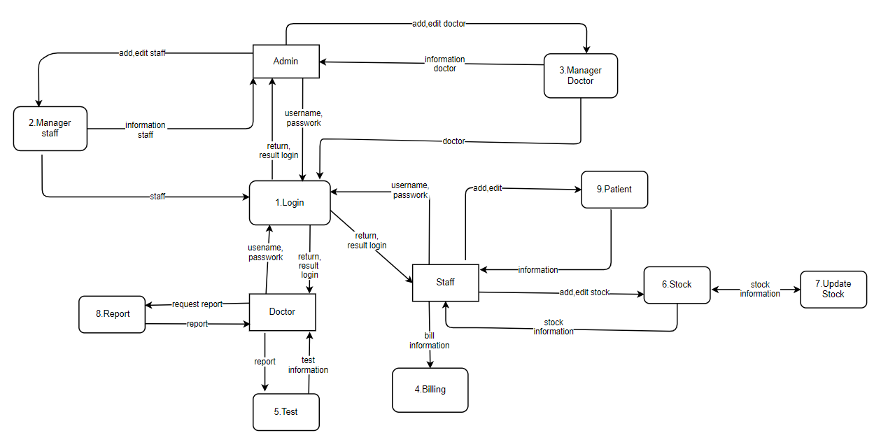
DFD LEVEL 0

Slide 9
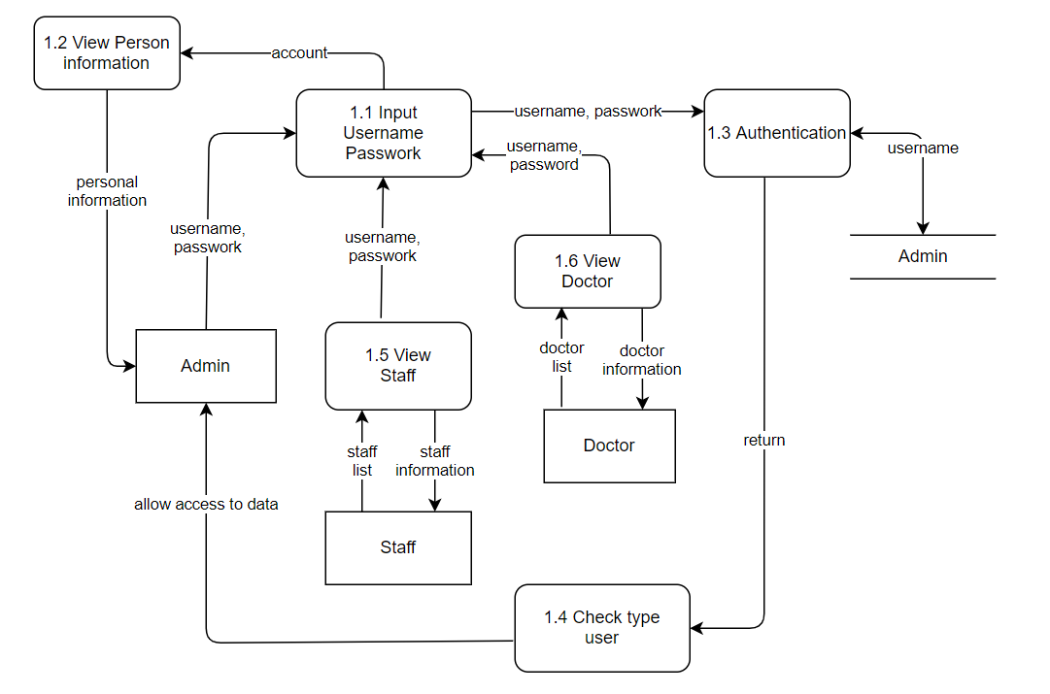
DFD LEVEL 1 ADMINISTRATION

Slide 10
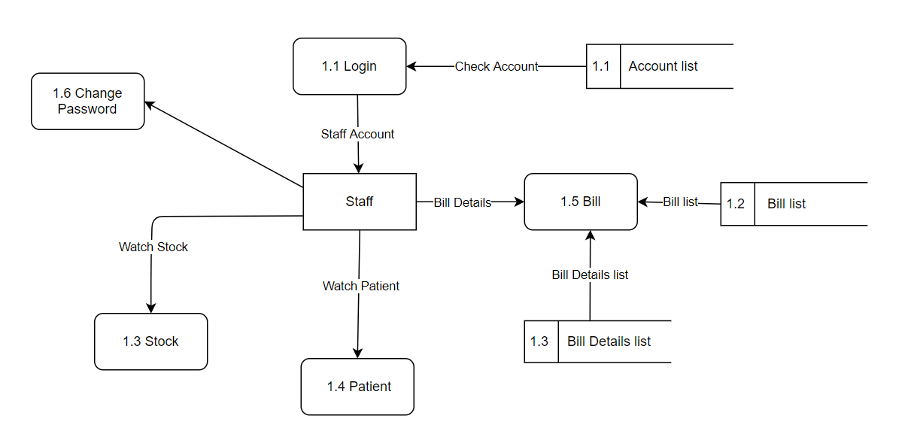
DFD LEVEL STAFF

Slide 11
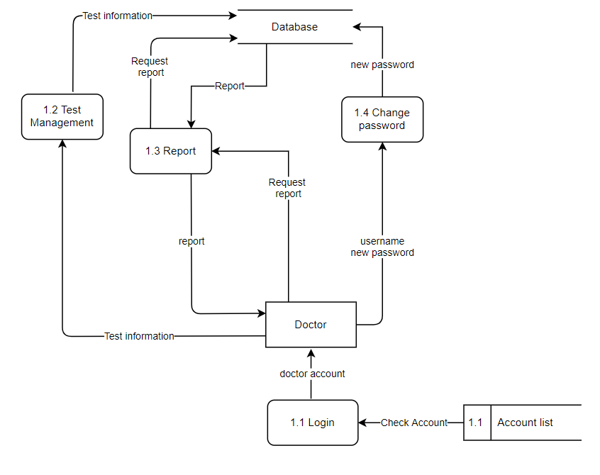
DFD LEVEL 1 DOCTOR

Slide 12
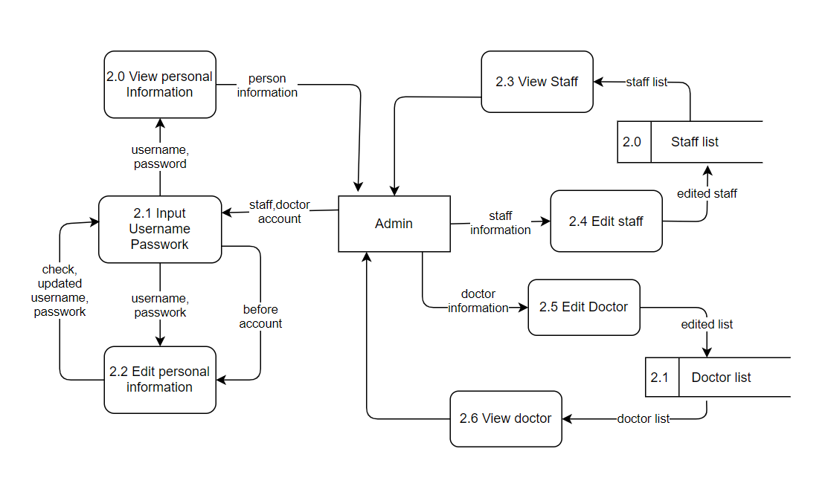
DFD LEVEL 2 ADMINISTRACTION

Slide 13
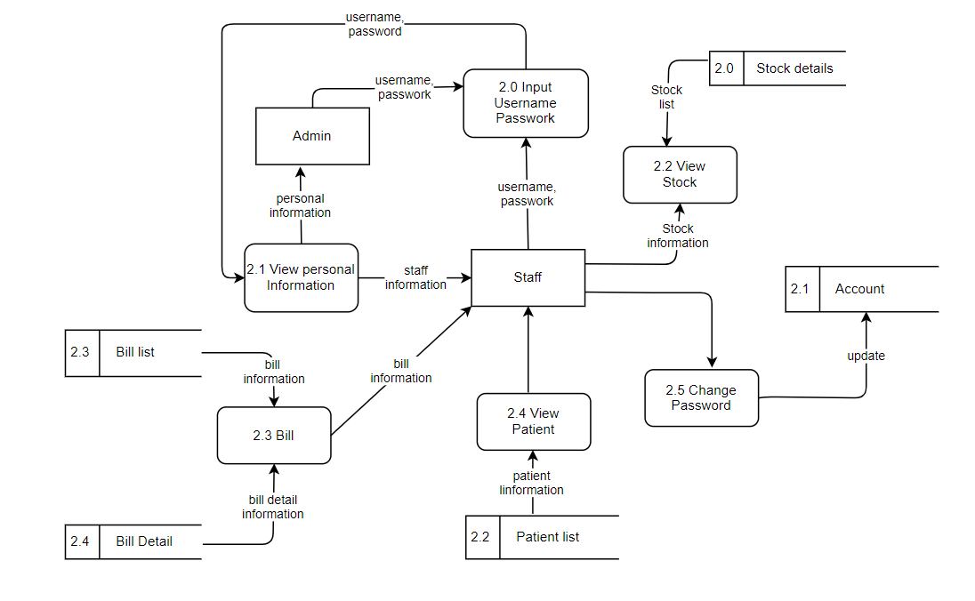
DFD LEVEL 2 STAFF

Slide 14
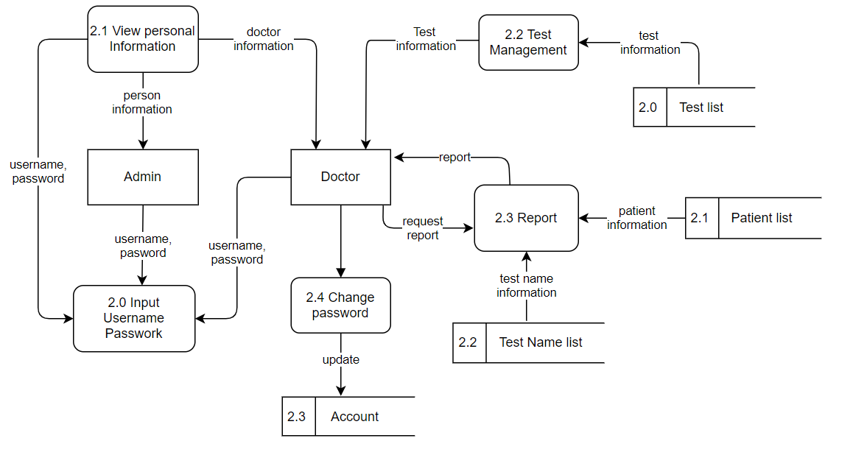
DFD LEVEL 2 DOCTOR

Slide 15
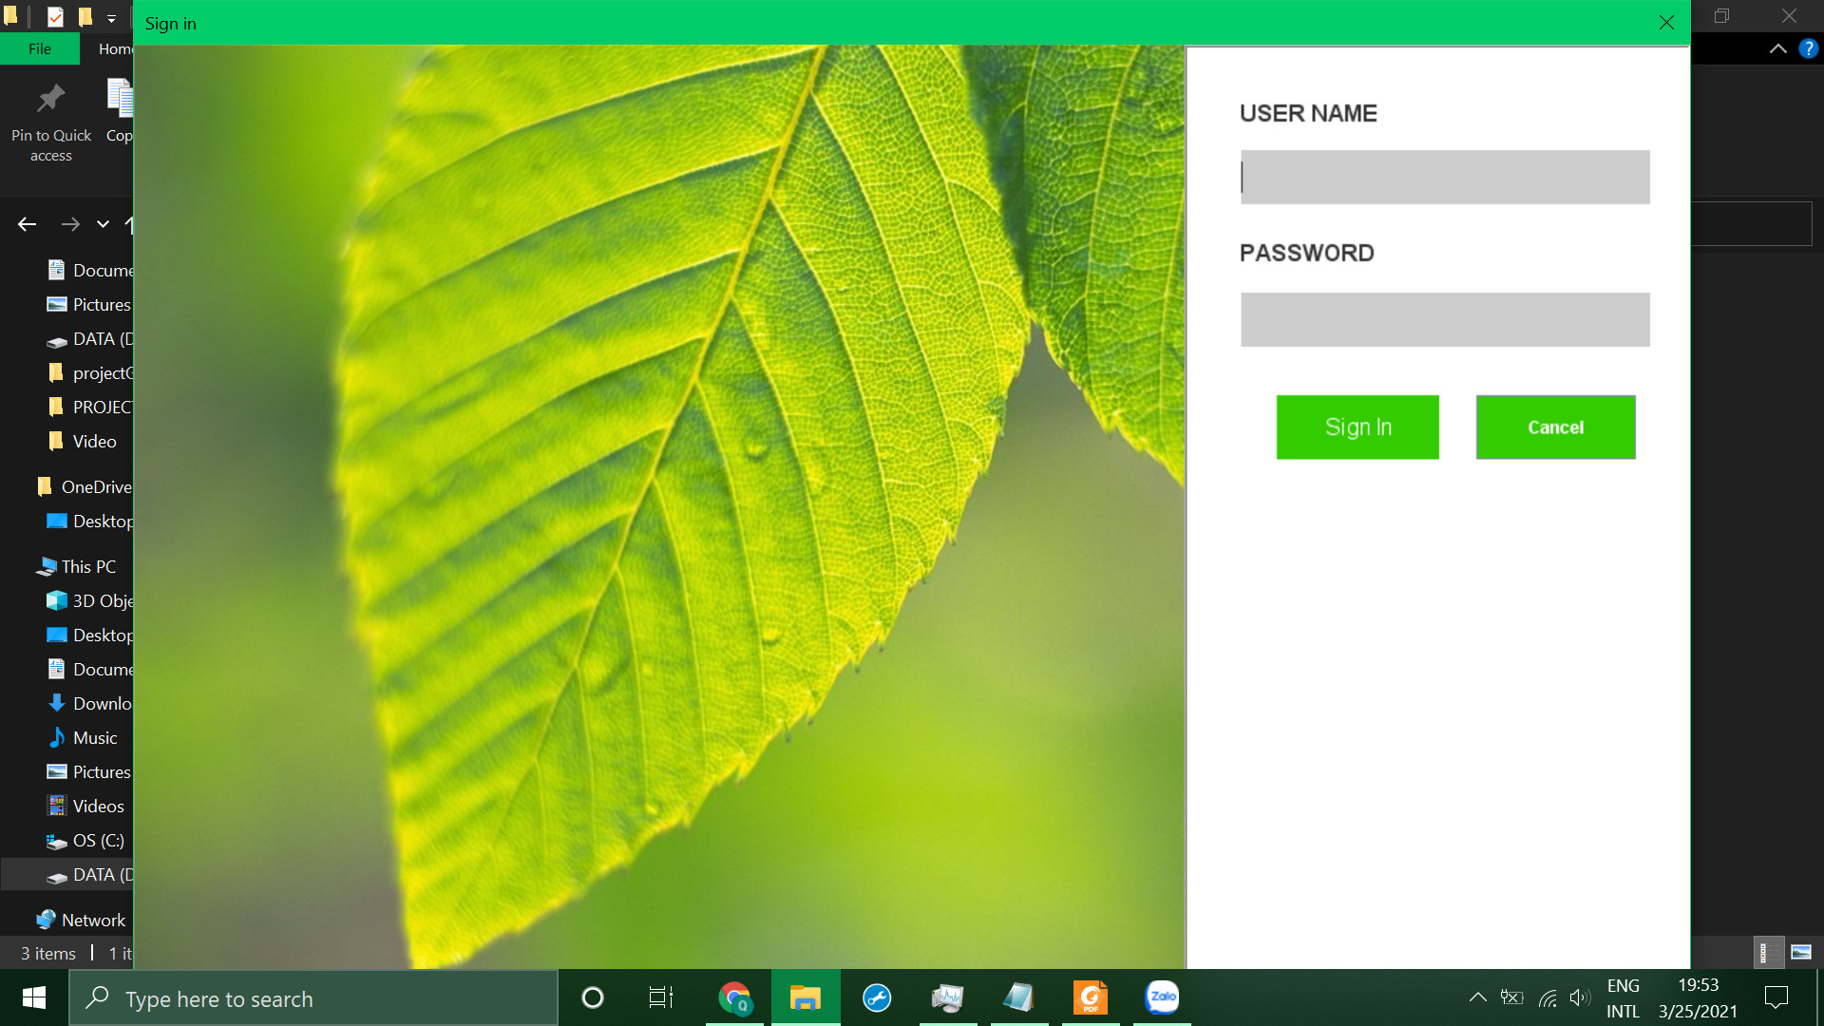
LOGIN

Slide 16
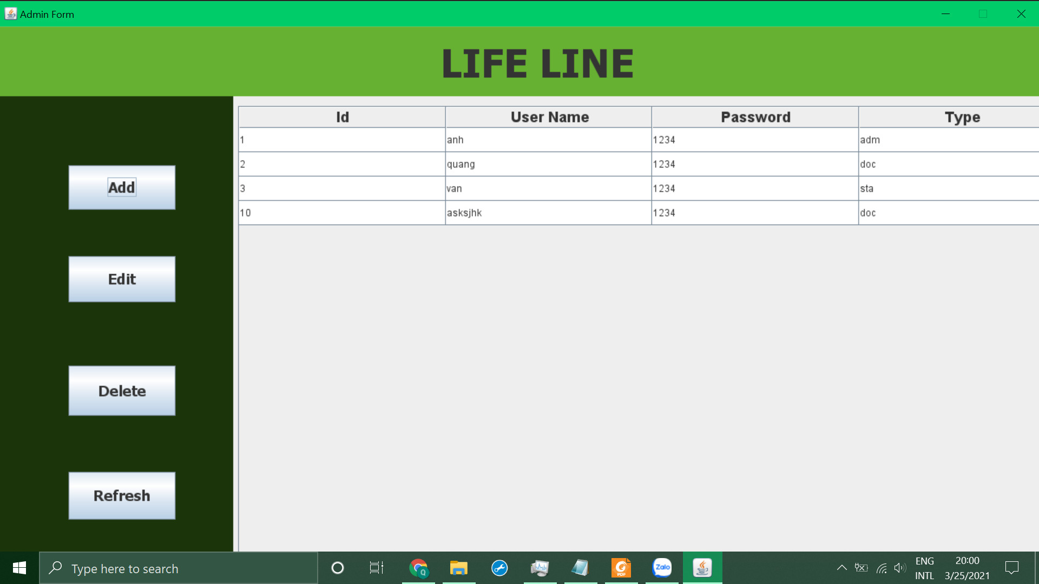
ADMIN

Slide 17
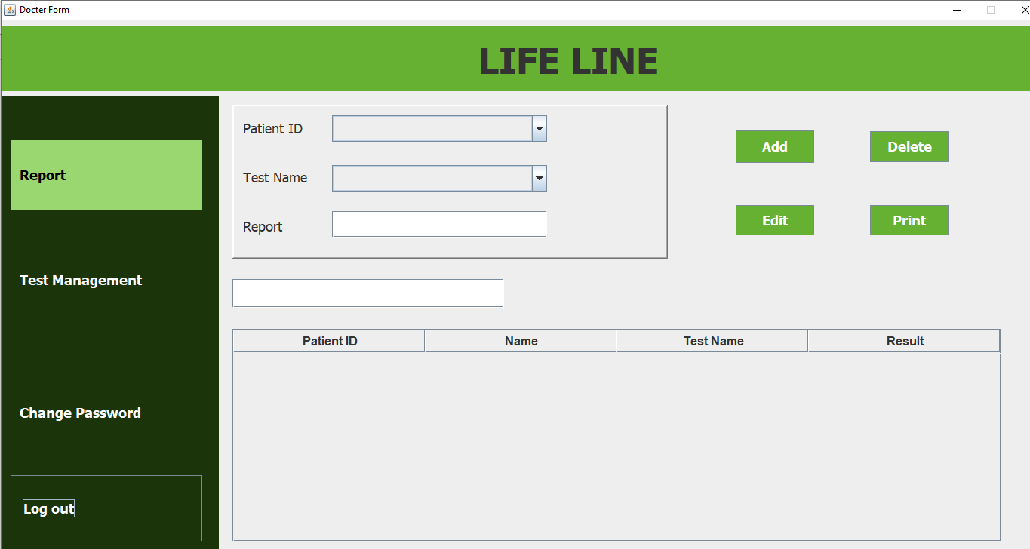
DOCTOR

Slide 18
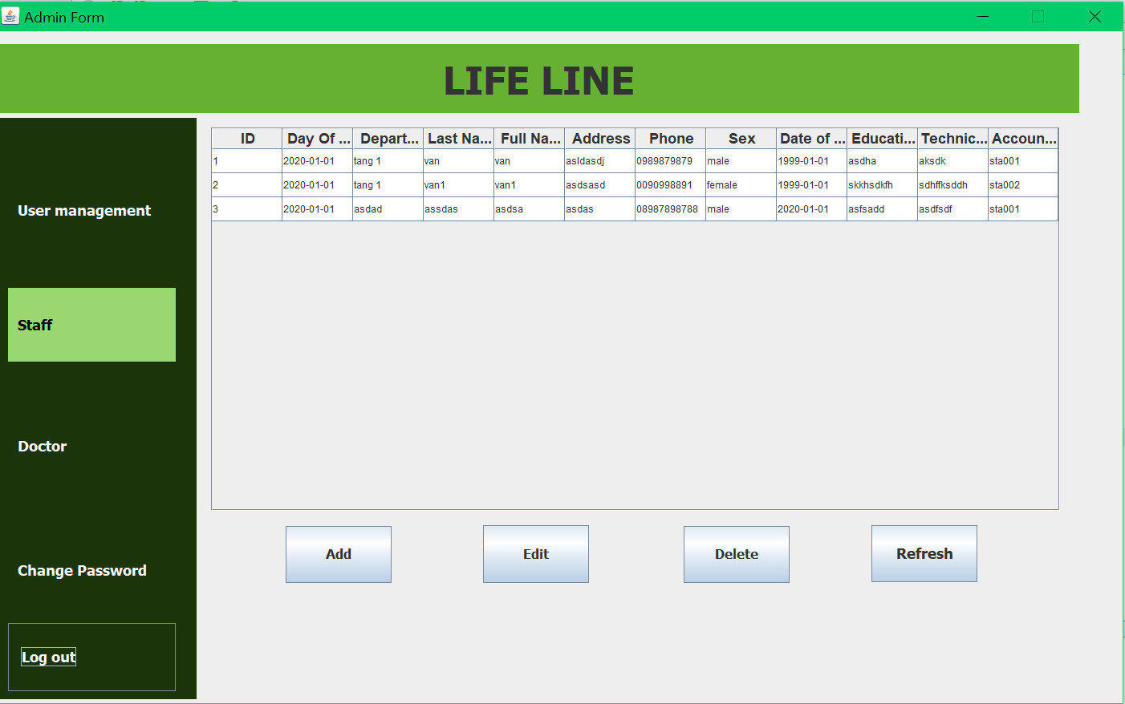
STAFF

Slide 19
Thanks!

